Slide 1
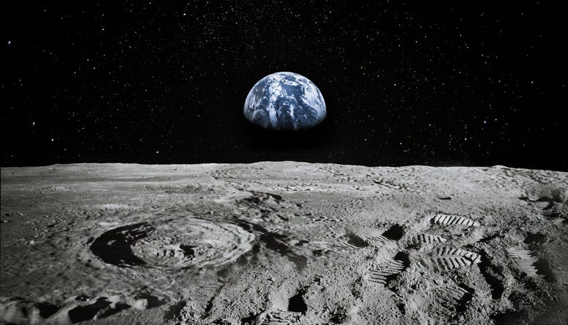
LUNAR LANDING PAYLOAD CRANE
Alanna Black | Jayson Dickinson | Christina Morrow | Ryker Mullinix
TEAM 517

Slide 2
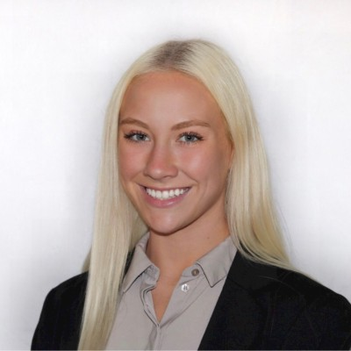
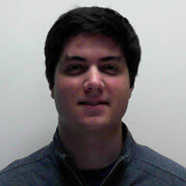
Meet Team 517
Alanna Black
Jayson Dickinson
Christina Morrow
Ryker Mullinix
Robotics &
Controls Engineer
Project Manager &
Fluid Dynamics Engineer
Design & Test
Engineer
Materials Engineer
Alanna Black

Slide 3
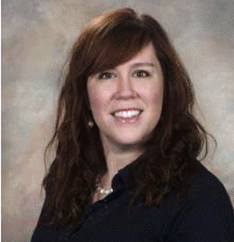
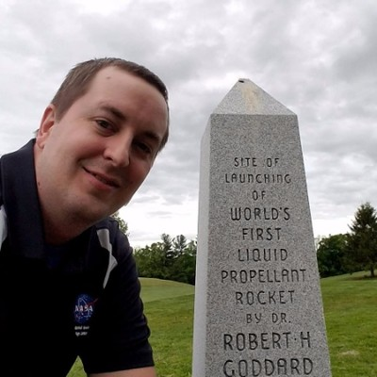
Sponsor & Advisor
Rachel McCauley
Justin Rowe
Dr. Eric Hellstrom
NASA Marshall Space
Flight Center
NASA Marshall Space
Flight Center
FAMU-FSU
College of Engineering
Alanna Black
Notes:
Our sponsor for this project is NASA, specifically the Marshal Space Flight Center.
Rachel McCauley is a supervisor there and oversees our project, but Justin Rowe has been our main point of contact.
And our academic advisor is Dr. Hellstrom.

Slide 4
Project Background
NASA Plans for
Lunar Base
NASA Developed Payload Crane
v
v
Artemis Mission
Announced
Design Payload Crane Off-loader
Alanna Black
Notes:
Now to give a little background context for our project
So, NASA, along with everyone else, has been dreaming of our return to the moon. And setting up a lunar base.
The Artemis mission was announced in May of 2019, with those goals.
After that, NASA developed a payload crane (which is the LSMS). This crane would be used to unload all of the payloads on the lander and then help set up the lunar base, and more.
So, this is where our team comes in. Currently, the LSMS is fixed to the CLPS moon lander, with no way of detaching or offloading it. So, it’s purpose is very limited because it can only reach things to take them off of the lander.

Slide 5
Motivation
Alanna Black
Notes:
So, the driving motivation behind the project, is get the LSMS into a position where it can have a wider application, meaning it can set up the base, um, they hope to use it for 3D printing applications, and many more creative ways of utilizing the LSMS. But it’s all dependent on getting it off of the CLPS lander and down onto the lunar surface.

Slide 6
Motivation
Alanna Black

Slide 7
Project Objective
The objective of this project is to offload the LSMS (Lightweight Surface Manipulation System) from the CLPS (Commercial Lunar Payload Services) lander onto a platform.
Alanna Black
Notes:
The objective of our project is to offload the LSMS from the CLPS lander onto a platform on the lunar surface.
The LSMS, which stands for “lightweight surface manipulation system” is the payload crane that NASA has developed.
The CLPS lander was developed by “Commercial Lunar Payload Services”.

Slide 8
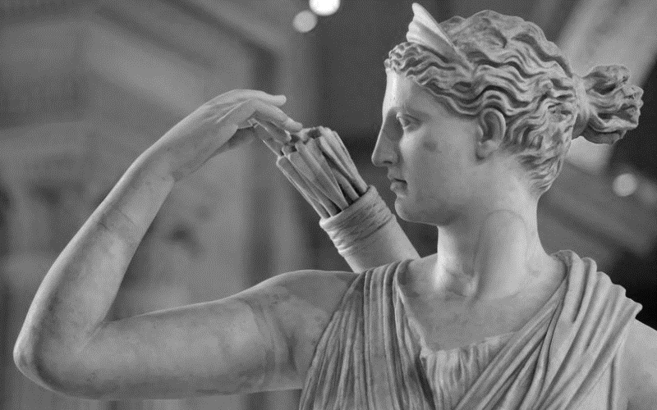
Artemis Background
Goddess of the Hunt
SYMBOLOGY The bow and arrow are the primary symbols of the Greek Goddess Artemis.
ARTEMIS PROGRAM PATCH The overall shape is symbolic of an arrowhead.
The silver background is drawn from Greek mythology
where Artemis’ bow and arrows are silver.
Alanna Black
Notes:
Artemis from Greek mythology is the goddess of the hunt
Her primary symbols are the bow and arrow
And actually, the NASA patch made for the Artemis mission is full of symbology too.
The shape represents an arrowhead, and the silver background is symbolic of Artemis’ silver bow and arrows.
ALSO, if you want to mention (don’t have to) that Artemis is the twin sister of Apollo (The first mission to the moon was the Apollo mission)

Slide 9
A
R
R
O
W
AUTOMATED AND RANGED RELOCATION OF THE LSMS FOR WIDER APPLICATION
Alanna Black
Notes:
So our team thought it would be a creative way of tying our project into the mission as a whole, if we named our eventual design ARROW, which stands for “automated and ranged relocation of the LSMS for wider application”
So, if you hear a reference to the ARROW or see the acronym ARROW, it is referring to our eventual design for an off-loader.

Slide 10
Targets & Metrics
MOTION
COMMUNICATION
POWER
SUPPORT
Alanna Black
Notes:
Last design review, we talked about our functional decomposition process, breaking down the needs of our project into different system, and further into viable functions in each system.
These were the four main system that came out of that process: Motion, Support, Power, and Communication.
So now, we’ve broken it down even further and assigned a target and metric to each of the functions.

Slide 11
Targets & Metrics
z
X-AXIS
Y-AXIS
Z-AXIS
Move about Axes
0°
180°
360°
x
Relocate the LSMS
0.525 m
0.225 m
0.75 m
y
Alanna Black
Notes:
Looking at the motion functions, we’ve established that the arrow will move 180 degrees about either the X or the Y axis and 360 degrees about the z-axis.
It was in our assumptions that the LSMS will be attached to the CLPS peregrine lander for the Artemis mission. Based on the dimensions of the Peregrine Lander, we know that the LSMS needs to be relocated 0.525m in the x direction, 0.255m in the y direction, and 0.75m down to the ground (z direction)

Slide 12
Targets & Metrics
Decrease LSMS
Position Error
±2.54 cm
±10 deg
Secure LSMS
110 N
Release LSMS
±2.54 cm
Scale for Variable
LSMS Size
1:1
Alanna Black
Notes:
These are the functions related to our support system.
Our first function was to decrease the LSMS position error. These values are based on a paper published by our sponsor with position tolerances related to the LSMS connection to an end-effector. So we assigned those same positional tolerances to relocating the LSMS. We want to get within 2.54cm of our XY goal and within 10 degrees alignment.

Slide 13
Targets & Metrics
Decrease LSMS
Position Error
±2.54 cm
±10 deg
Secure LSMS
110 N
Release LSMS
±2.54 cm
Scale for Variable
LSMS Size
1:1
Alanna Black
Notes:
Next, we need to secure the LSMS. We quantified this in terms of the grip force needed to secure and support movement of the LSMS. This value of 1334 Newtons is based off of the force needed to lift the scaled LSMS that we’ll be using for our demonstration, which weighs around 150 lbs in earth gravity.

Slide 14
Targets & Metrics
Decrease LSMS
Position Error
±2.54 cm
±10 deg
Secure LSMS
110 N
Release LSMS
±2.54 cm
Scale for Variable
LSMS Size
1:1
Alanna Black
Notes:
Next, we have to Release the LSMS. We quantified this in terms of a clearance value. We want to make sure that the ARROW has at least a 2.54cm clearance on all sides of the LSMS when the LSMS begins to move away from the ARROW.

Slide 15
Targets & Metrics
Decrease LSMS
Position Error
±2.54 cm
±10 deg
Secure LSMS
110 N
Release LSMS
±2.54 cm
Scale for Variable
LSMS Size
1:1
Alanna Black
Notes:
Lastly, we need to scale for variable LSMS sizes. *******************************************************

Slide 16
Targets & Metrics
Receive Power
1800 Watts
Convert Power to Torque
276 Nm
Alanna Black
Notes:
Now we’re looking at our Power system.
The ARROW has access to 1800 Watts, so it needs to receive that power.

Slide 17
Targets & Metrics
Receive Power
1800 Watts
Convert Power to Torque
276 Nm
Alanna Black

Slide 18
Targets & Metrics
Receive Power
1800 Watts
Convert Power to Torque
276 Nm
Alanna Black
Notes:
We also need to convert that power to torque, based on the weight of the LSMS on the moon (25 lbs), we know that we’ll need 276 Newton Meters to move the LSMS.

Slide 19
Targets & Metrics
Transmit Signal
2.4 GHz
Receive Signal
2.4 GHz
Transduce Signal
120 Volts
Process Signal
18 ms
Alanna Black
Notes:
This is our Communication System, most of these target values are based of values similar to what you’d see with RC cars. Through talking with out sponsor, he said that this was a perfectly fine assumption to make. It’s not far from what they’re actually using and for a proof-of-concept project, they would suffice.
So based on that, we’ll need 2.4 Ghz to transmit a signal. This is needed because the ARROW will need to communicate with the LSMS.
We’ll also need 2.4 Ghz in to receive a signal from the LSMS.
120 Volts will be needed to transduce the signal into something meaningful.
Lastly, we’re shooting for a processing time of 18ms. Based on the research we did about RC car, 18ms seemed to be a reasonable response time.

Slide 20
Targets & Metrics
Transmit Signal
2.4 GHz
Receive Signal
2.4 GHz
Transduce Signal
120 Volts
Process Signal
18 ms
Alanna Black

Slide 21
Targets & Metrics
Transmit Signal
2.4 GHz
Receive Signal
2.4 GHz
Transduce Signal
120 Volts
Process Signal
18 ms
Alanna Black

Slide 22
Targets & Metrics
Transmit Signal
2.4 GHz
Receive Signal
2.4 GHz
Transduce Signal
120 Volts
Process Signal
18 ms
Alanna Black

Slide 23
Concept Generation
Brainstorm
Morphological Chart
Biomimicry
Alanna Black

Slide 24
Medium Fidelity
Mating connector for the LSMS end-effector, located via plug connection
Four-bar Mechanism
Fingerlike end-effector that locates the LSMS via RFID
Winch attached to the Chariot mobility chassis
Scissor-lift Platform
01
02
03
04
05
Alanna Black

Slide 25
Medium Fidelity
Mating connector for the LSMS end-effector, located via plug connection
Four-bar Mechanism
Fingerlike end-effector that locates the LSMS via RFID
Winch attached to the Chariot mobility chassis
Scissor-lift Platform
01
02
03
04
05
Alanna Black

Slide 26
Medium Fidelity
Mating connector for the LSMS end-effector, located via plug connection
Four-bar Mechanism
Fingerlike end-effector that locates the LSMS via RFID
Winch attached to the Chariot mobility chassis
Scissor-lift Platform
01
02
03
04
05
Alanna Black

Slide 27
Medium Fidelity
Mating connector for the LSMS end-effector, located via plug connection
Four-bar Mechanism
Fingerlike end-effector that locates the LSMS via RFID
Winch attached to the Chariot mobility chassis
Scissor-lift Platform
01
02
03
04
05
Alanna Black

Slide 28
Medium Fidelity
Mating connector for the LSMS end-effector, located via plug connection
Four-bar Mechanism
Fingerlike end-effector that locates the LSMS via RFID
Winch attached to the Chariot mobility chassis
Scissor-lift Platform
01
02
03
04
05
Alanna Black

Slide 29
Medium Fidelity
Mating connector for the LSMS end-effector, located via plug connection
Four-bar Mechanism
Fingerlike end-effector that locates the LSMS via RFID
Winch attached to the Chariot mobility chassis
Scissor-lift Platform
01
02
03
04
05
Alanna Black

Slide 30
Medium Fidelity
Mating connector for the LSMS end-effector, located via plug connection
Four-bar Mechanism
Fingerlike end-effector that locates the LSMS via RFID
Winch attached to the Chariot mobility chassis
Scissor-lift Platform
01
02
03
04
05
Alanna Black

Slide 31
Medium Fidelity
Mating connector for the LSMS end-effector, located via plug connection
Four-bar Mechanism
Fingerlike end-effector that locates the LSMS via RFID
Winch attached to the Chariot mobility chassis
Scissor-lift Platform
01
02
03
04
05
Alanna Black

Slide 32
Medium Fidelity
Mating connector for the LSMS end-effector, located via plug connection
Four-bar Mechanism
Fingerlike end-effector that locates the LSMS via RFID
Winch attached to the Chariot mobility chassis
Scissor-lift Platform
01
02
03
04
05
Alanna Black

Slide 33
Medium Fidelity
Mating connector for the LSMS end-effector, located via plug connection
Four-bar Mechanism
Fingerlike end-effector that locates the LSMS via RFID
Winch attached to the Chariot mobility chassis
Scissor-lift Platform
01
02
03
04
05
Alanna Black

Slide 34
Medium Fidelity
Mating connector for the LSMS end-effector, located via plug connection
Four-bar Mechanism
Fingerlike end-effector that locates the LSMS via RFID
Winch attached to the Chariot mobility chassis
Scissor-lift Platform
01
02
03
04
05
Alanna Black

Slide 35
Medium Fidelity
Mating connector for the LSMS end-effector, located via plug connection
Four-bar Mechanism
Fingerlike end-effector that locates the LSMS via RFID
Winch attached to the Chariot mobility chassis
Scissor-lift Platform
01
02
03
04
05
Alanna Black

Slide 36
Medium Fidelity
Mating connector for the LSMS end-effector, located via plug connection
Four-bar Mechanism
Fingerlike end-effector that locates the LSMS via RFID
Winch attached to the Chariot mobility chassis
Scissor-lift Platform
01
02
03
04
05
Alanna Black

Slide 37
Medium Fidelity
Mating connector for the LSMS end-effector, located via plug connection
Four-bar Mechanism
Fingerlike end-effector that locates the LSMS via RFID
Winch attached to the Chariot mobility chassis
Scissor-lift Platform
01
02
03
04
05
Alanna Black

Slide 38
Medium Fidelity
Mating connector for the LSMS end-effector, located via plug connection
Four-bar Mechanism
Fingerlike end-effector that locates the LSMS via RFID
Winch attached to the Chariot mobility chassis
Scissor-lift Platform
01
02
03
04
05
Alanna Black

Slide 39
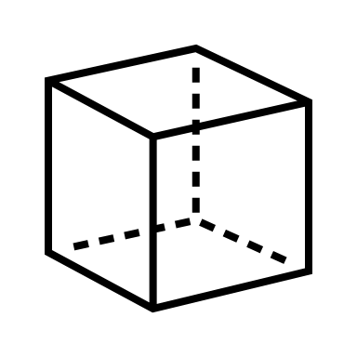
High Fidelity
Lazy SUSAN
Fingerlike
End-Effector
Acrobat LSMS
Alanna Black

Slide 40
High Fidelity
Lazy SUSAN
Jayson Dickinson

Slide 41
High Fidelity
Lazy SUSAN
Jayson Dickinson

Slide 42
High Fidelity
Lazy SUSAN
Jayson Dickinson

Slide 43
High Fidelity
Lazy SUSAN
Jayson Dickinson

Slide 44
High Fidelity
Lazy SUSAN
Jayson Dickinson

Slide 45
High Fidelity
Lazy SUSAN
Jayson Dickinson

Slide 46
High Fidelity
Lazy SUSAN
Jayson Dickinson

Slide 47
High Fidelity
Lazy SUSAN
Fingerlike
End-Effector
Acrobat LSMS
Jayson Dickinson

Slide 48
High Fidelity
Fingerlike
End-Effector
Jayson Dickinson

Slide 49
High Fidelity
Fingerlike
End-Effector
Jayson Dickinson

Slide 50
High Fidelity
Fingerlike
End-Effector
Jayson Dickinson

Slide 51
High Fidelity
Fingerlike
End-Effector
Jayson Dickinson

Slide 52
High Fidelity
Fingerlike
End-Effector
Jayson Dickinson

Slide 53
High Fidelity
Fingerlike
End-Effector
Jayson Dickinson

Slide 54
High Fidelity
Lazy SUSAN
Fingerlike
End-Effector
Acrobat LSMS
Jayson Dickinson

Slide 55
High Fidelity
Acrobat LSMS
Jayson Dickinson

Slide 56
High Fidelity
Acrobat LSMS
Jayson Dickinson

Slide 57
High Fidelity
Acrobat LSMS
Jayson Dickinson

Slide 58
High Fidelity
Acrobat LSMS
Jayson Dickinson

Slide 59
High Fidelity
Acrobat LSMS
Jayson Dickinson

Slide 60
High Fidelity
Acrobat LSMS
Jayson Dickinson

Slide 61
High Fidelity
Acrobat LSMS
Jayson Dickinson

Slide 62
Concept Selection
Pairwise
Comparison
Pugh Chart
+
S
House of
Quality
Analytical
Hierarchy
Process
Jayson Dickinson
Notes:
Slide idea was taken from https://poweredtemplate.com/four-steps-hiring-process-75689/

Slide 63
Concept Selection
Pairwise Comparison
AUTONOMY
SCALABILITY
Jayson Dickinson

Slide 64
Concept Selection
House of Quality
Decrease LSMS
Position Error
Move about Axes
Transduce Signal
Scale for Variable
LSMS Size
Release
LSMS
Relocate the LSMS
Process
Signal
Receive
Power
Jayson Dickinson

Slide 65
Concept Selection
House of Quality
Decrease LSMS
Position Error
Move about Axes
Transduce Signal
Scale for Variable
LSMS Size
Release
LSMS
Relocate the LSMS
Process
Signal
Receive
Power
Jayson Dickinson

Slide 66
Concept Selection
Pugh Chart
Jayson Dickinson

Slide 67
Concept Selection
Pugh Chart
Jayson Dickinson

Slide 68
Concept Selection
Pugh Chart
Jayson Dickinson

Slide 69
Concept Selection
Analytical Hierarchy Process
Jayson Dickinson

Slide 70
Concept Selection
Analytical Hierarchy Process
Jayson Dickinson

Slide 71
Concept Selection
Analytical Hierarchy Process
Jayson Dickinson

Slide 72
Final Selection
Gear driven turntable
Powered through LSMS
wrist and CLPS
Actuated pins to secure
LSMS
ARROW
Jayson Dickinson

Slide 73
Initial Design
Connection Housing
Actuated Pins & Plug Connection
Actuated pins and revolution powered through LSMS wrist
Revolution Axis
Turntable
Gearbox and turntable powered through CLPS
Gearbox Housing
Jayson Dickinson

Slide 74
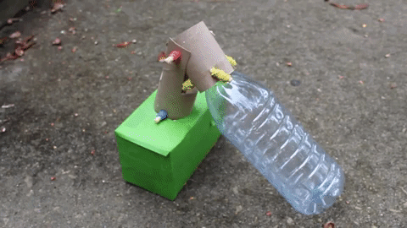
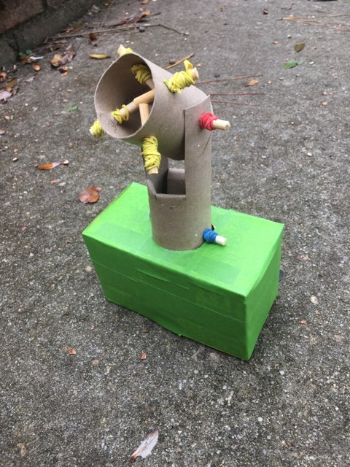
Prototyping
NOTE: For demonstration, the LSMS is represented
using a plastic water bottle.
Jayson Dickinson

Slide 75
Timeline
Fall Semester Timeline
Prototype no. 1
VDR 2
Bill of Materials
Risk Assessment
November
December
Jayson Dickinson

Slide 76
Timeline
Spring Semester Timeline
VDR3
CAD
Automation
VDR4
3D Printing
Prototype no. 2
Testing
Presentation
January
February
March
April
May
Jayson Dickinson

Slide 77
TEAM 517
Alanna Black
anb16c@my.fsu.edu
Jayson Dickinson
jpd15e@my.fsu.edu
LUNAR LANDING PAYLOAD CRANE
Christina Morrow
cjm18bn@my.fsu.edu
Ryker Mullinix
rwm18c@my.fsu.edu

Slide 78
References
Dorsey, J., Jones, T., Doggett, W., King, B., Mercer, C., Brady, J., . . . Ganoe, G. (2011). Recent Developments in the Design, Capabilities and Autonomous Operations of a Lightweight Surface Manipulation System and Test-bed. AIAA SPACE 2011 Conference & Exposition. doi:10.2514/6.2011-7266
Doggett, W. (., King, B., Jones, T., Dorsey, J., & Mikulas, M. (2008). Design and Field Test of a Mass Efficient Crane for Lunar Payload Handling and Inspection: The Lunar Surface Manipulation System. AIAA SPACE 2008 Conference & Exposition. doi:10.2514/6.2008-7635
PEREGRINE LUNAR LANDER: PAYLOAD USER’S GUIDE [PDF]. (2020, June). Astrobotic Technology.
Jefferies, S., Doggett, W., Chrone, J., Angster, S., Dorsey, J., Jones, T., . . . Caldwell, D. (2010). Lunar Lander Offloading Operations Using a Heavy-Lift Lunar Surface Manipulator System. AIAA SPACE 2010 Conference & Exposition. doi:10.2514/6.2010-8804
Dorsey, J., Jones, T., Doggett, W., King, B., Mikulas, M., & Roithmayr, C. (2009). Developments to Increase the Performance, Operational Versatility and Automation of a Lunar Surface Manipulation System. AIAA SPACE 2009 Conference & Exposition. doi:10.2514/6.2009-6795
Dorsey, J., Mikulas, M., & Doggett, W. (2008). Preliminary Structural Design Considerations and Mass Efficiencies for Lunar Surface Manipulator Concepts. AIAA SPACE 2008 Conference & Exposition. doi:10.2514/6.2008-7916

Slide 79
Background Info - Artemis
Artemis Mission Milestones:
Scheduled to Launch in 2023
Sending the next man and first woman to the moon
Major goal is to set up a lunar base
Photos from nasa.gov

Slide 80
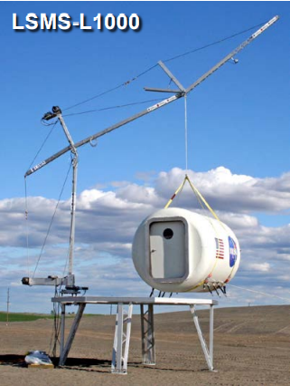
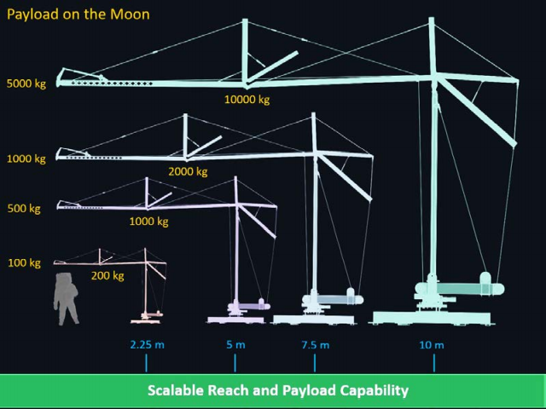
Background Info - LSMS
Versatile and Multi-Functional:
Precision Payload Lifting / Unloading
Large-Scale 3-D Printing
Assembly, and Regolith Excavation and Handling
Astronaut Elevator
Deploying Structures + Science
Connections, E-Beam Welding
NASA LSMS Crane
Info and Photos from Presentation Given by Tom Jones

Slide 81
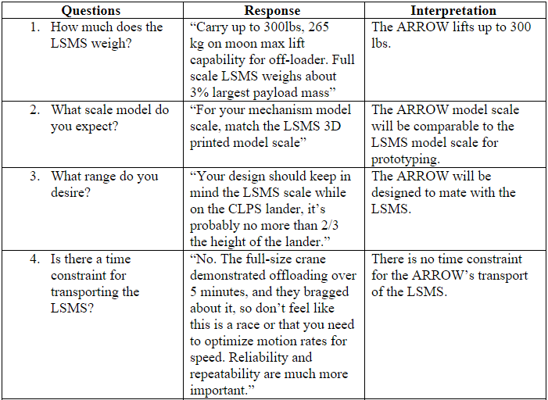
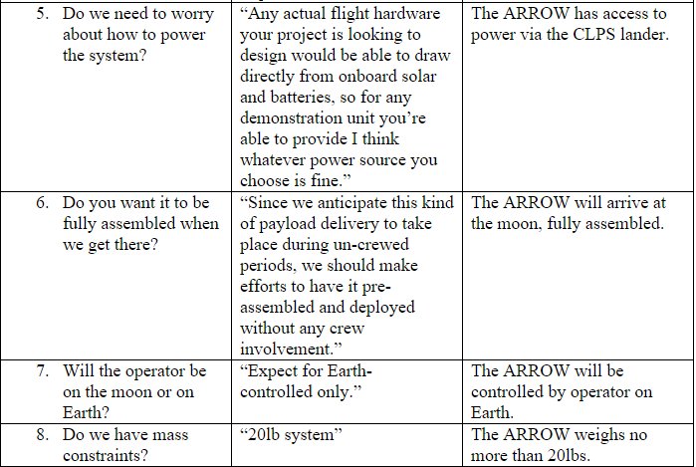
Customer Needs (new)

Slide 82
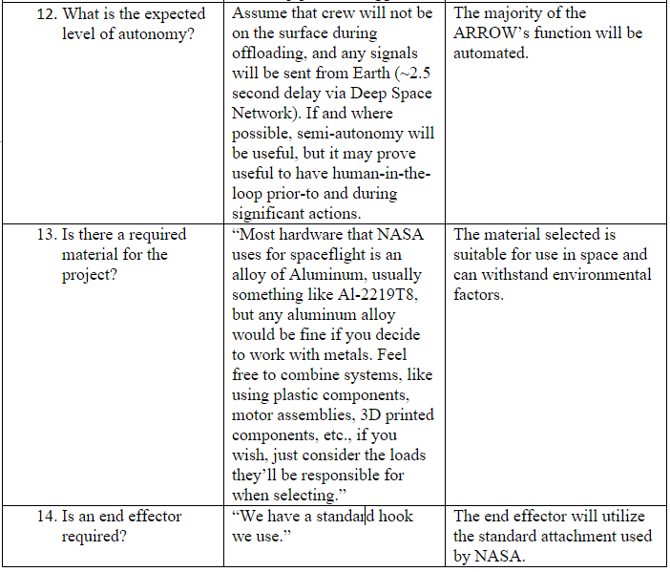
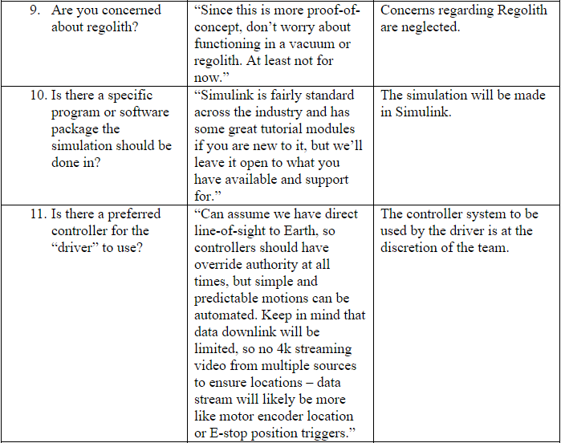
Customer Needs (new)

Slide 83
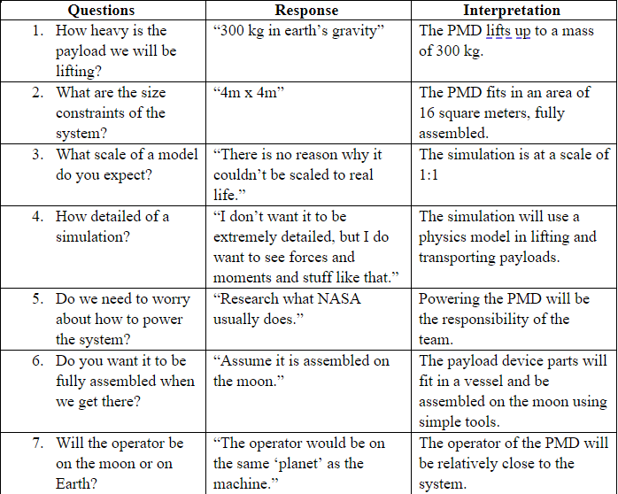
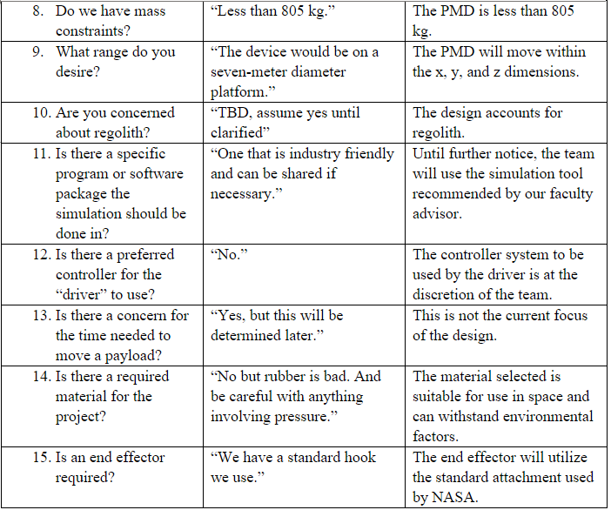
Customer Needs (old)

Slide 84
Key Goals – SAE Standards

Slide 85
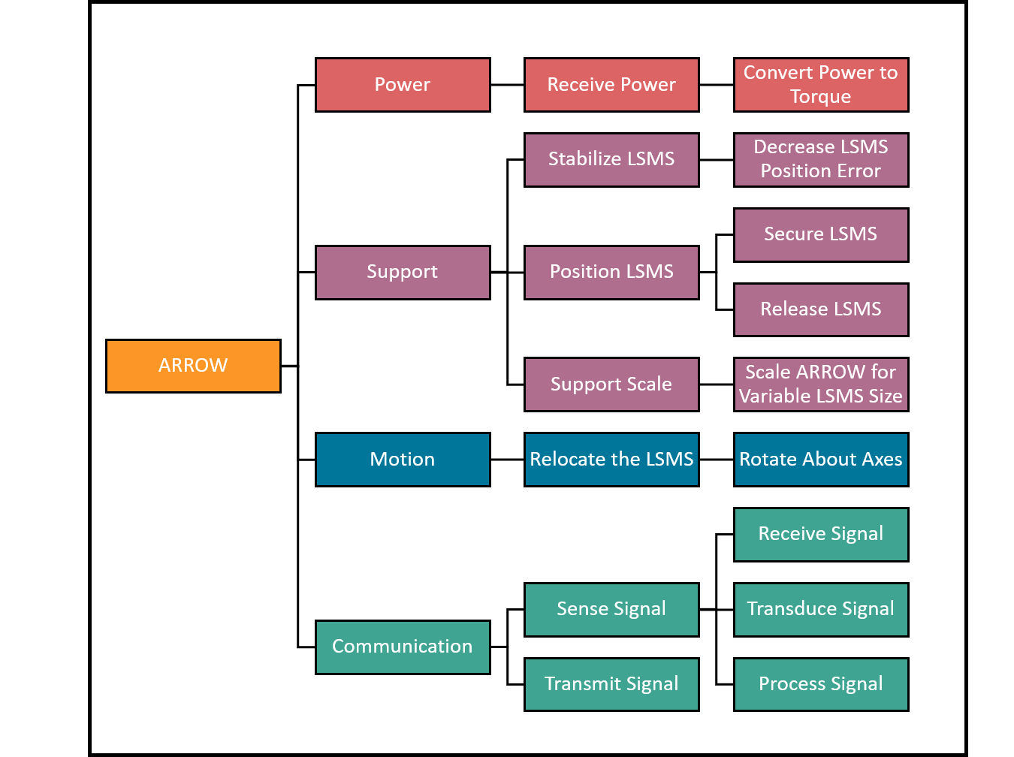
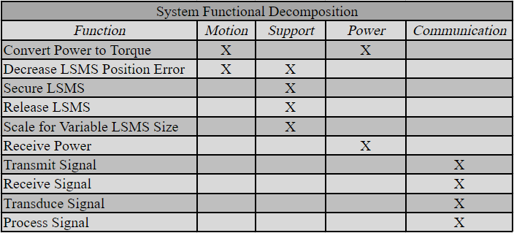
Functional Decomposition (new)
Cross Reference Table
Hierarchy Flow Chart

Slide 86
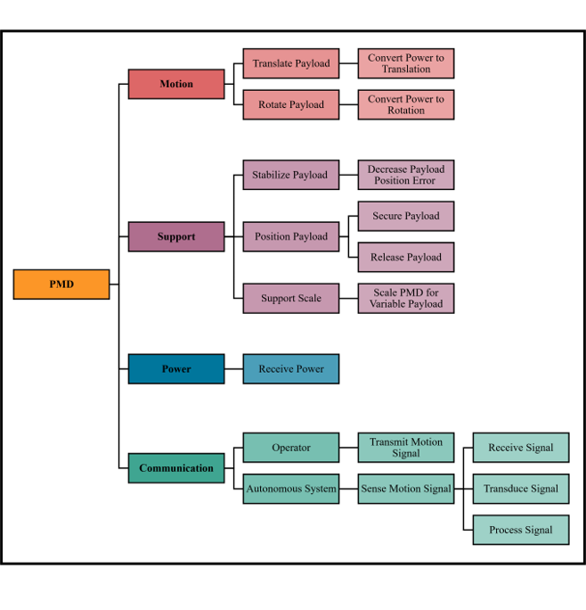
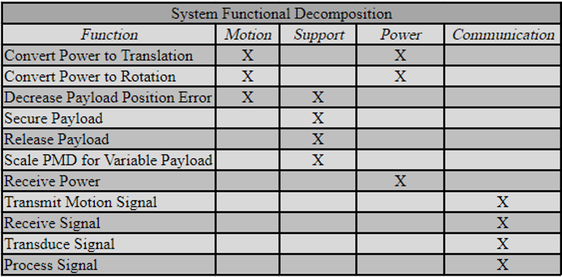
Functional Decomposition (old)
Cross Reference Table
Hierarchy Flow Chart

Slide 87
Targets & Metrics

Slide 88
Concept Generation

Slide 89
Concept Selection

Slide 90
Concept Selection

Slide 91
Concept Selection

Slide 92
Concept Selection

Slide 93
Concept Selection

Slide 94
Concept Selection

Slide 95
Concept Selection

Slide 96
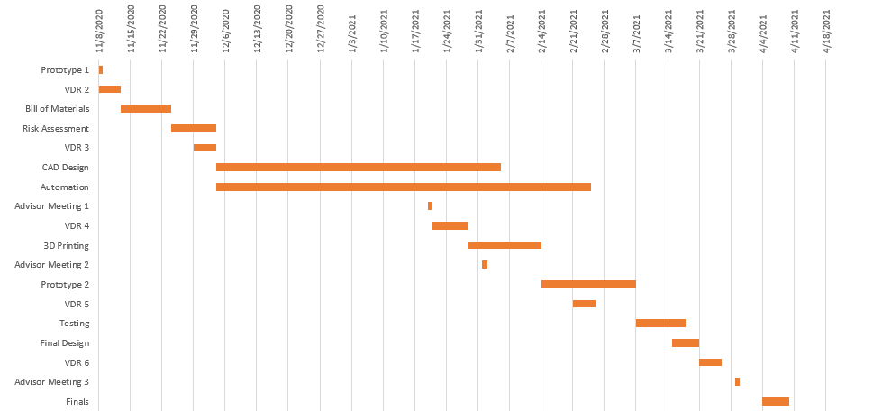
Gantt Chart

Slide 97
Color Palette

Slide 98
Team 517 Icons
Lunar Base Module
ARROW
Rotate about Z-axis
Rotate about Y-axis
CLPS Lander
LSMS
Mobility Chassis
4m
Ryker

